Slide 1
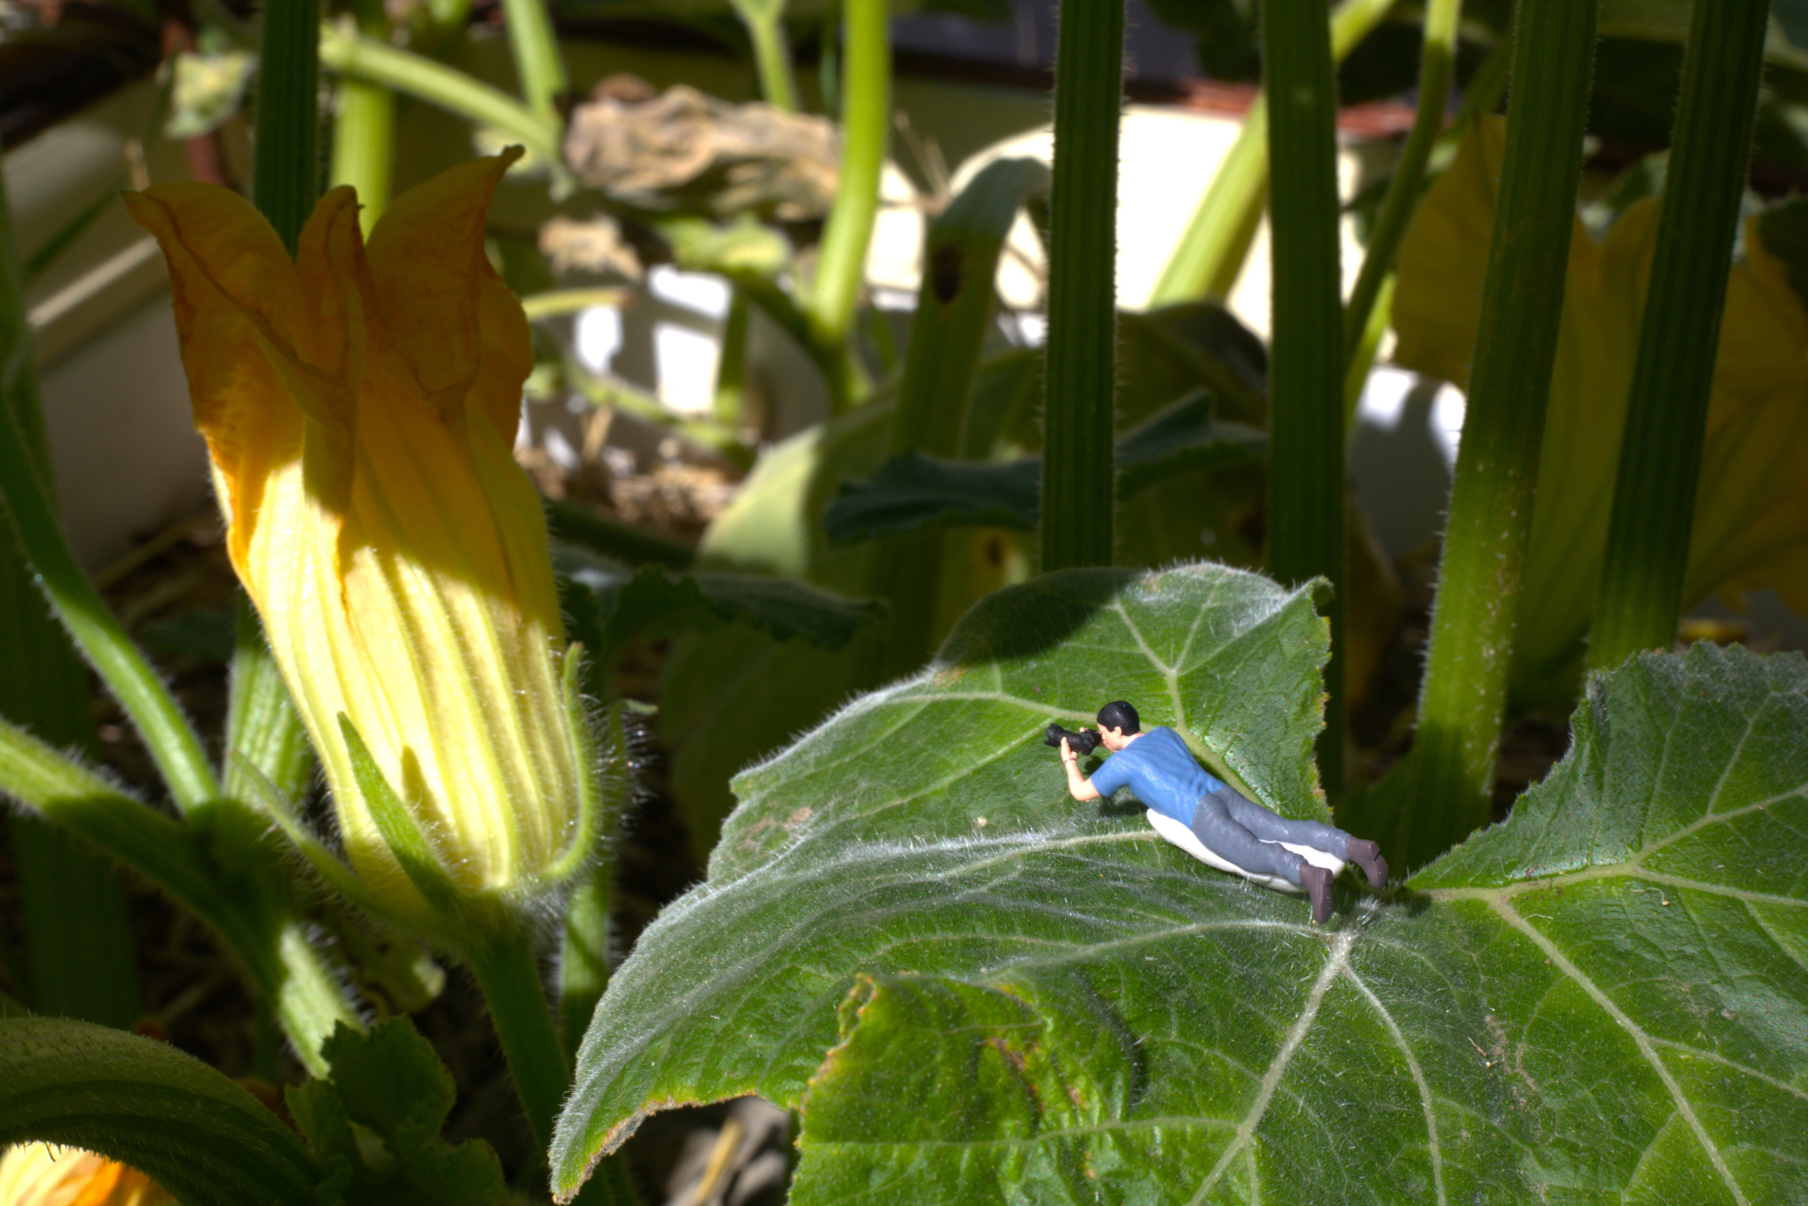
Perspectives and Response
Year 8 Assignment Task
(Hutton, B. ‘Giant Flower’, 2025)
Notes:
Welcome to the Year 8 Assignment Task. Today we are looking at various perspectives in the form of a photograph. We will be starting to think about how we would respond to these photographs by various photographers using very clever perspective.
We will be exploring visual conventions, elements and principles to understand to work out how the photographers designed their images.
Your task will be to anaylise and respond by using a design process to brainstorm, create, make and photograph.
Who can first tell me what perspective is? (Pause for response).

Slide 2
Acknowledgement of Country
Notes:
So lets start by understanding what is perspective.
The TATE Gallery defines perspective as…. (read the blurb)

Slide 3
In photography what is perspective?
The TATE Gallery (2025) defines perspective as:
Perspective in art usually refers to the representation of three-dimensional objects or spaces in two dimensional artworks. Artists use perspective techniques to create a realistic impression of depth, 'play with' perspective to present dramatic or disorientating images.
Perspective can also mean a point of view – the position from which an individual or group of people see and respond to, the world around them. You might, for example, hear people saying 'from my perspective' or referring to the point of view of a particular group or set of beliefs: 'the youth perspective' or 'the feminist perspective'.
Notes:
So, lets start by understanding what is perspective.
The TATE Gallery defines perspective as…. (read the blurb)

Slide 4
Various perspectives
Linear Perspective
Ariel
Angles
Cityscapes
Large and Small
Use of space
Notes:
Perspectives can be varied. Expand on the dot points….

Slide 5
Let’s explore…
Notes:
So let us explore…

Slide 6
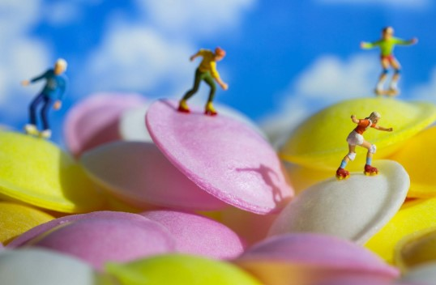
David Gilliver
LITTLE PEOPLE
Gilliver, D. ‘Untitled’, 2024
Little people – David Gilliver Photography
Notes:
Here we have David Gilliver’s series of Little People…. You have access on the website to this presentation and the link to his website is below.
Feel free to click and view a lot more of his images, as this may give you extra inspiration or images to analyse for the Response template you will need to complete.
I’m just going to show you this image to start silently thinking about his photograph. What might it mean?
(Give students a minute or two to think)….

Slide 7
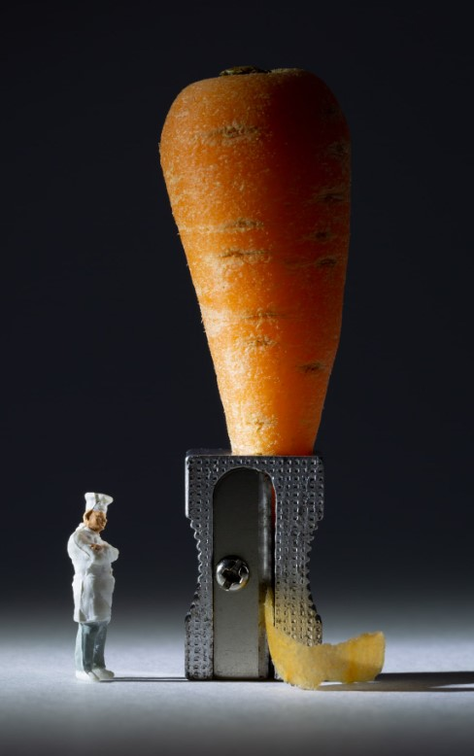
What do you see?
What do you see that makes you say that?
What more can we find?
Gilliver, D. ‘Untitled’, 2024
Little people – David Gilliver Photography
Notes:
Here we have another of David Gilliver’s image….
What do you see?
What do you see to make you say that? Paraphrase….
What more can we find?

Slide 8
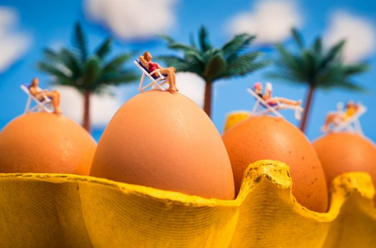
Tell me more about Little People…
What more can we find?
Gilliver, D. ‘Untitled’, 2024
Little people – David Gilliver Photography
Notes:
Here is another image?
Tell me more about ‘Little People’…
What more can we find?
What similarities are there between the three images?
(Make sure to paraphrase the student’s response)

Slide 9
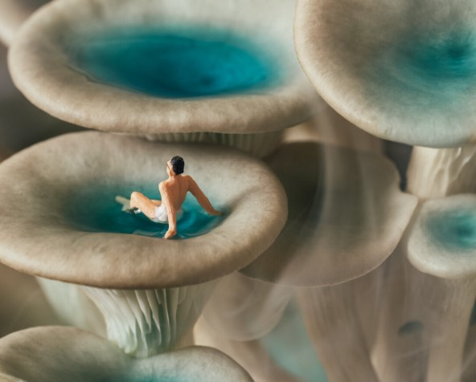
Erin outdoors
MINIATURE PHOTOGRAPHY
(Outdoors, E. ‘Untitled’, 2024)
Miniatures
Notes:
Erin Outdoors is another photographer that cleverly uses perspective.
Why do you think she has created this image?

Slide 10
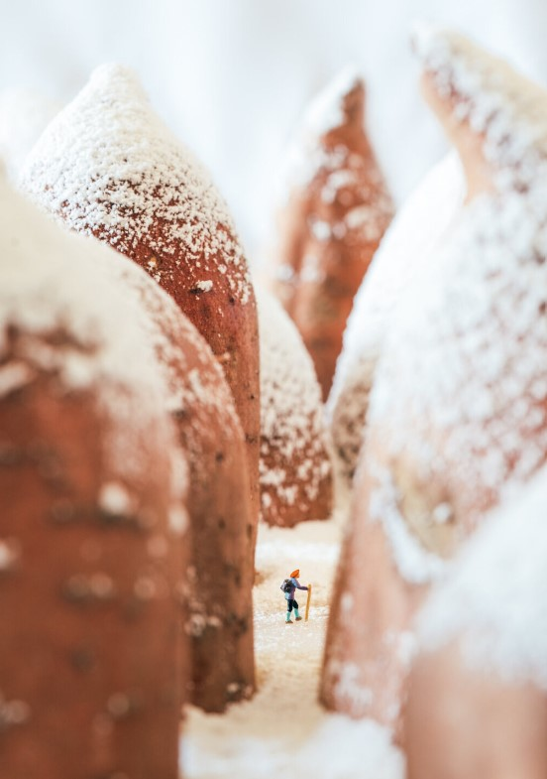
What do we see?
Why do you say that?
Tell me more about this image?
(Outdoors, E. ‘Sweet Potato Mountain’, 2024)
Miniatures
Notes:
What do we see here?
Why do you say that?
What meaning do you think this image creates?
Tell me more…. (Paraphrase)

Slide 11
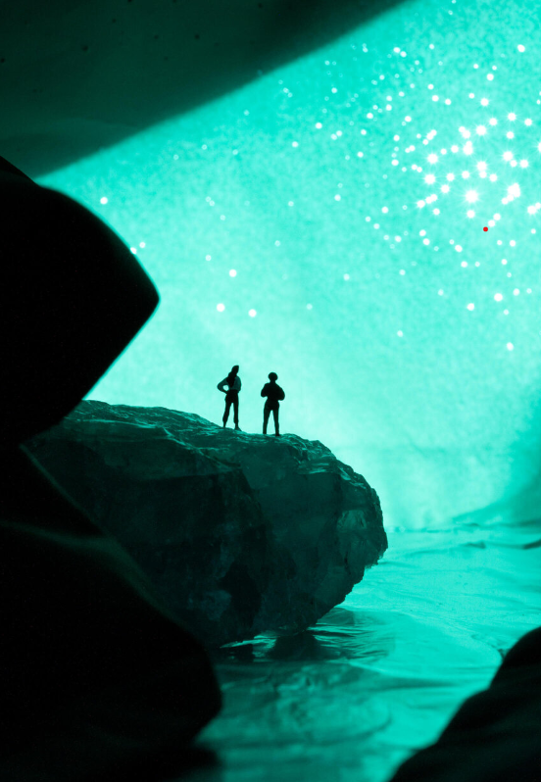
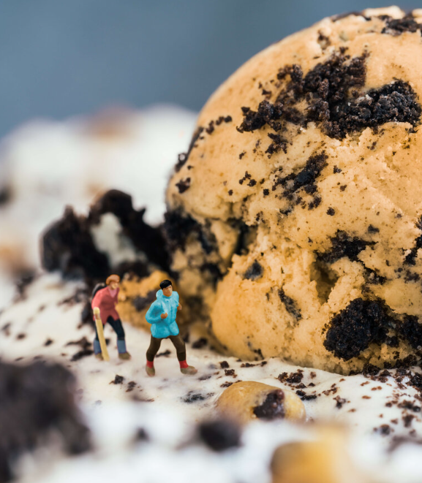
(Outdoors, E. ‘Untitled’, 2024)
(Outdoors, E. ‘Oero Sonic’, 2024)
Miniatures
Notes:
What materials are manipulated has she used and how?
What processes have been used to create these images?
Are there similarities between these images?
Why do you think she has created these images?
Once again, her website link is down below to view all her images…. They are worth the look.

Slide 12
How do you think they created these?
Tell me what sort of materials were used? What materials would you use?
Tell me the type of design process used? How would you design a photograph like this?

Slide 13
INDIGENOUS PERSPECTIVES
Salty One – Modern Aboriginal Photographic Art Printss
Salty One, ‘Centered’, 2024
Notes:
We must consider Indigenous Perspectives.
As per discussion earlier, these perspective are of a different type.
How do you think this was created and what sort of perspective do you think it is?

Slide 14
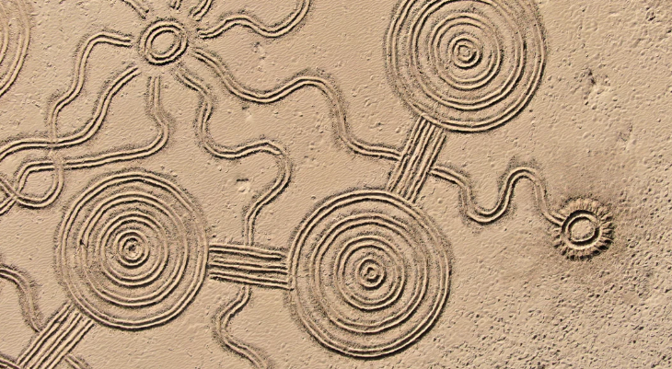
Tell me the type of perspective this is?
How and what was the process of this image?
Tell me if you understand the meaning of this image?
Salty One, Working Together #4,2024
Salty One – Modern Aboriginal Photographic Art Printss
Notes:
Tell me the type of perspective this is?
How and what was the process of this image?
Tell me if you understand the meaning of this image?
(Rephrase any of the student’s response)

Slide 15
Is there significance of this image and the picture in the sand?
What materials would be used?
Salty One, Dolphin, Water, Sun and Spirit, 2024
Salty One – Modern Aboriginal Photographic Art Printss
Notes:
Can you tell me more about this image?
Is there significance of this image and the picture in the sand?
What materials would be used?
Is it simplistic or complex? Why do you say that?

Slide 16
Use these as Inspiration to Respond by:
Brainstorming
Generate Imaginative Ideas
Draw and Make with manipulation of materials
Create, Re-create and Photograph
Remember, it does not have to be complex!
Notes:
We are going to use these images for you to choose one and complete the Response template….
Then you are going to choose one image to respond to in your own way…. So, how do we do that?
We will commence by Brainstorming, generate ideas, draw and sketch, make and create, and photograph your final product.
At the end you will need to provide an image that you chose originally and your response to tell us why and how you created this…
We will have the class critique your image and please don’t think this is scary…. This is part of a design process and art making process….
Nothing is ever right or wrong in Art so be imaginative….. And creative….. Use materials around the house indoors or outdoors… See what you have lying around the house….

Slide 17
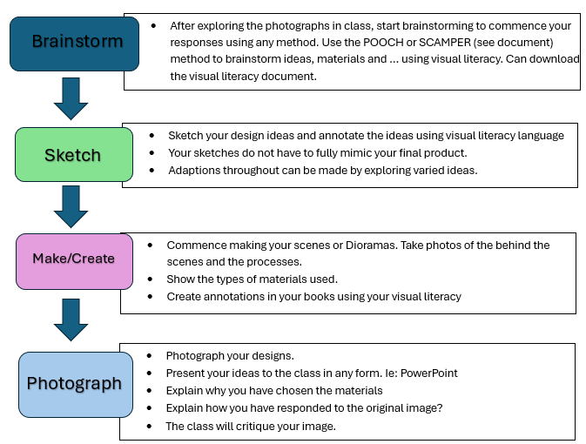
Step by Step Design Process
Notes:
The design process will consist of…. (read out the above) If you need examples or refresher on how to annotate, refer to the website with the resources.

Slide 18
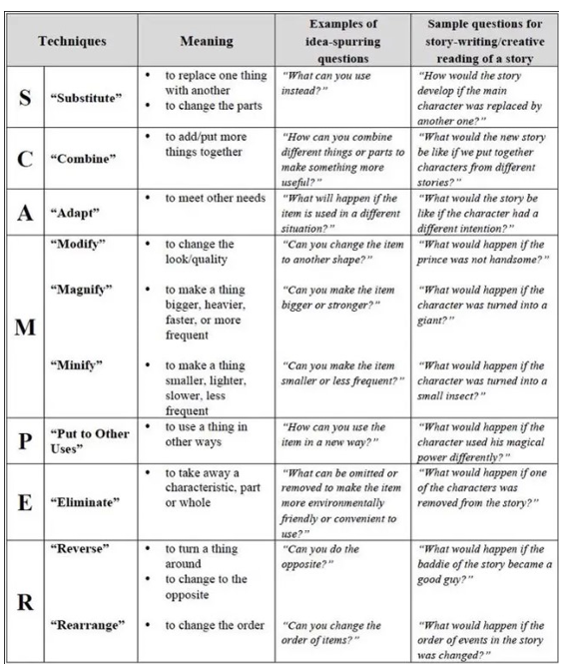
SCAMPER Method
Notes:
To start brainstorming and planning, you will need to either use the SCAMPER method of… (read this out)….

Slide 19
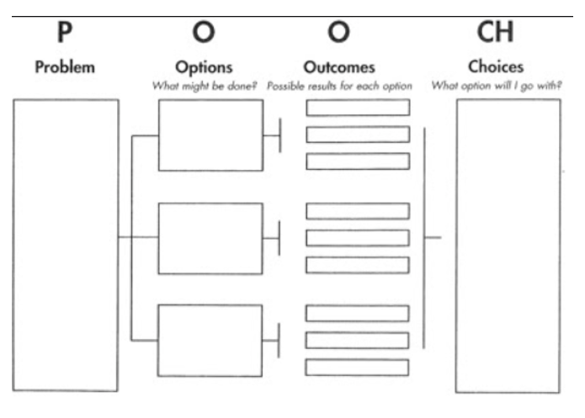
POOCH Method
Notes:
Or the POOCH method of…. (read the above)…..

Slide 20
Bronwyn’s examples
Notes:
I will provide a few of my own that I have undertaken….

Slide 21
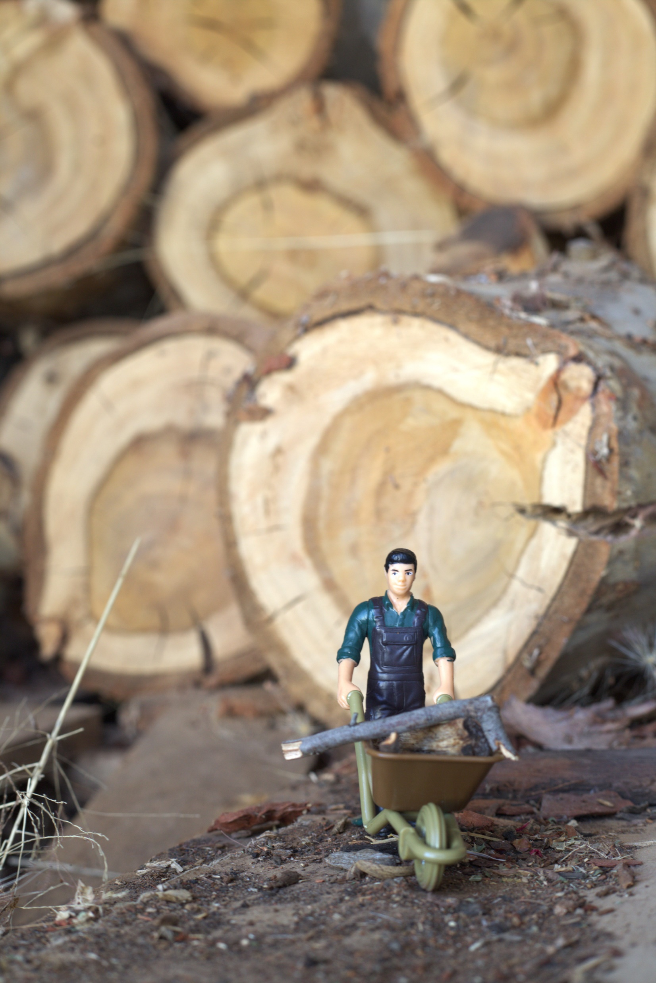
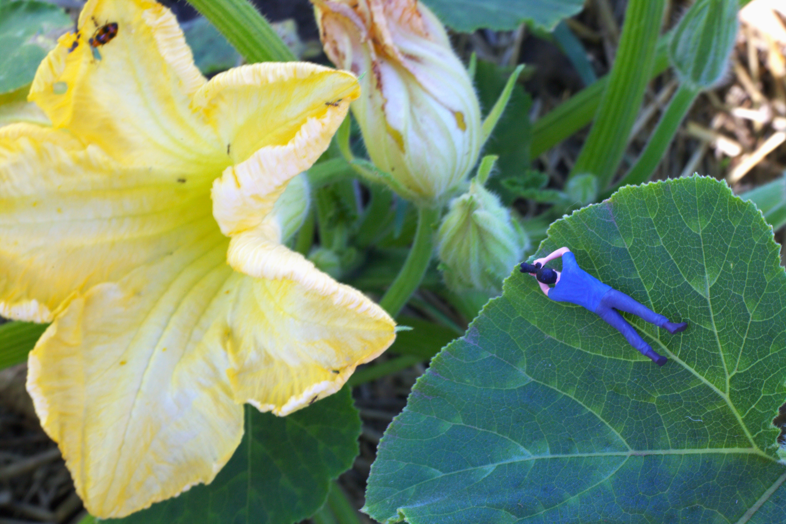
Bronwyn’s examples
Notes:
I will provide a few of my own that I have undertaken…. Feel free to critique…
Your designs and processes don’t have to be complex or a lot. You may have farm animals or figurines of some sort…. Stuffed toys…. Be creative….
Consider colour, black and white, composition and use your exposure triangle and/or basic techniques learnt in year 7. Remember, you can access these year 7 resources if need be.
On the website there is also glossary and terms set by Victorian Curriculum as links.

Slide 22
HAVE FUN
CREATING!
Notes:
Have fun creating!!!

